Slide 1
Revision

Slide 2
C - Command Line Arguments
It is possible to pass some values from the command line to your C programs when they are executed. These values are called command line arguments
The command line arguments are handled using main() function arguments where argc refers to the number of arguments passed, and argv[] is a pointer array which points to each argument passed to the program.

Slide 3
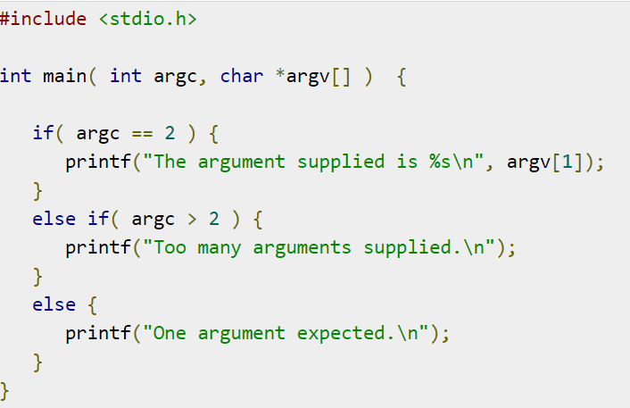
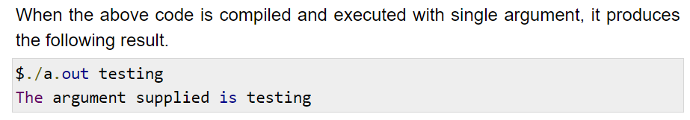
C - Command Line Arguments

Slide 4
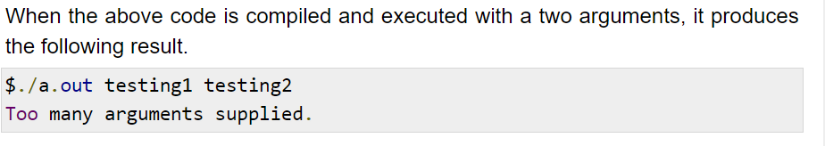
C - Command Line Arguments

Slide 5
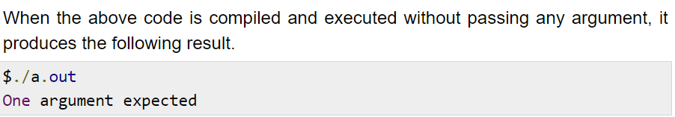
C - Command Line Arguments
Note: It should be noted that argv[0] holds the name of the program itself and argv[1] is a pointer to the first command line argument supplied,

Slide 6
C - Command Line Arguments
Properties of Command Line Arguments:
They are passed to main() function.
They are parameters/arguments supplied to the program when it is invoked.
They are used to control program from outside instead of hard coding those values inside the code.
argv[argc] is a NULL pointer.
argv[0] holds the name of the program.
argv[1] points to the first command line argument and argv[n] points last argument.

